Slide 1

Hospital Resource Failure Predictor
Team Members :
Ajay Kumar 1MS24IS400
Akshay Kumar 1MS24IS403
Dikshith S 1MS24IS406
Nuthana T M 1MS24IS410

Slide 2

The Critical Problem
Resource Failures Impact Lives
A pure logic-based system for predicting critical resource shortages before they happen
Hospitals face unpredictable resource demands that lead to critical situations:
Treatment delays due to ICU bed shortages
Surgery cancellations from insufficient blood units
Emergency mismanagement during demand spikes
Life-threatening situations from oxygen depletion
Traditional systems react to shortages. HRFP predicts them hours in advance.

Slide 3

Why Prediction Matters
No Early Warning
Blind Dependencies
Current systems lack predictive capabilities for oxygen, ventilator, or ICU failures
Oxygen shortages cascade into ventilator failures, affecting ICU capacity and surgical schedules
No Time Estimates
Black Box Systems
Hospitals cannot forecast when critical resources will run out or plan procurement accordingly
Existing solutions lack explainable, rule-based reasoning that staff can understand and trust

Slide 4
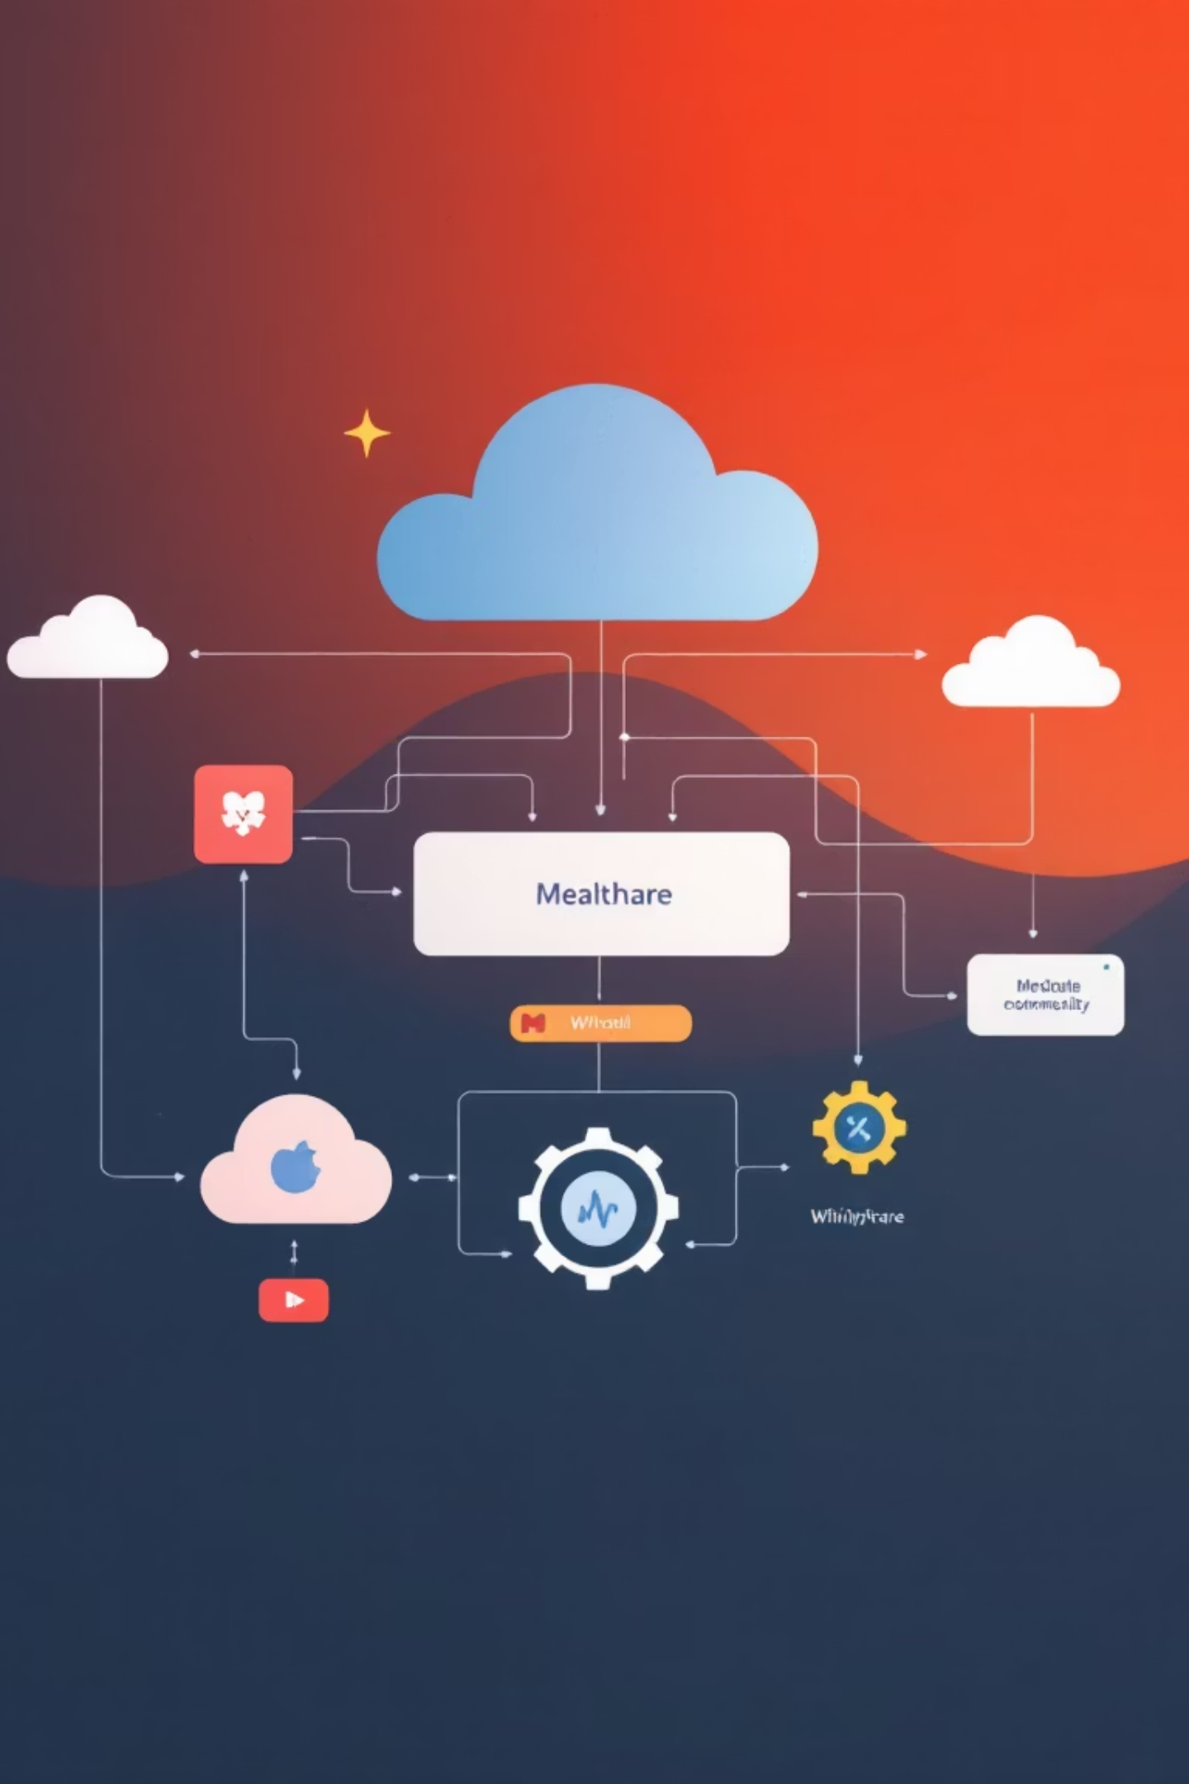




Our Solution: HRFP Architecture
Resource Input
Real-time data on ICU beds, oxygen, blood ,ventilators, staff and Pharmacy stocks
Rule Engine
JSON-based threshold evaluation and dependency matching
Three-Scold Model
Spike detection, dependency propagation, and time-to-failure prediction
Risk Output
Actionable alerts with severity scores and recommendations

Slide 5
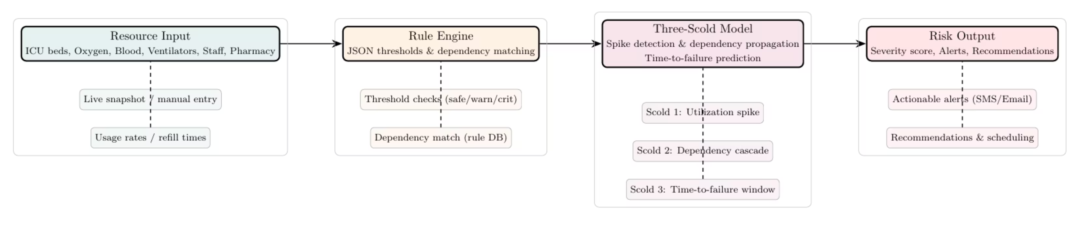
Flow chart

Slide 6

Why HRFP Stands Out
🎯 Real-World Impact
Addresses an urgent hospital challenge that directly affects patient safety and operational efficiency
🔍 Complete Transparency
100% explainable logic—no black-box algorithms. Staff understand exactly why alerts are triggered
🔗 Dependency Intelligence
Unique cascade analysis that maps how resource failures propagate across hospital systems
⚡ Deployment Ready
JSON input/output makes integration straightforward. Hospitals can customize rules instantly
HRFP transforms reactive crisis management into proactive resource planning—helping hospitals act early, avoid life-threatening shortages, and deliver safer patient care through intelligent, explainable predictions.

Slide 7
The Three-Scold Prediction Model
Our innovative three-layer approach provides comprehensive failure prediction:
Scold 3: Failure Window Prediction
Scold 2: Dependency Cascade Analysis
Scold 1: Utilization Spike Detection
Calculates precise time-to-failure using consumption rates. Formula: TTF = available resources / usage rate per hour. Provides actionable procurement timelines.
Maps how resource shortages propagate across hospital systems. Example: Low oxygen affects ventilators, which impacts ICU capacity, ultimately delaying surgeries.
Identifies rapid drops in resource availability that signal imminent stress. Triggers early alerts when consumption rates accelerate beyond normal patterns.

Slide 8

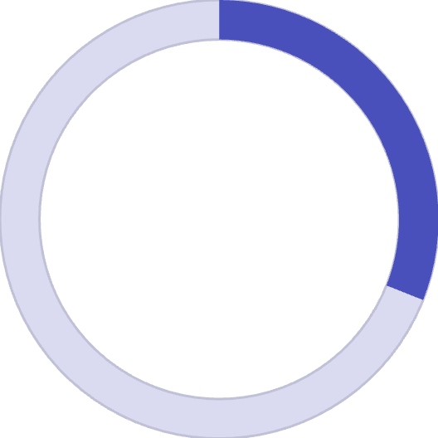

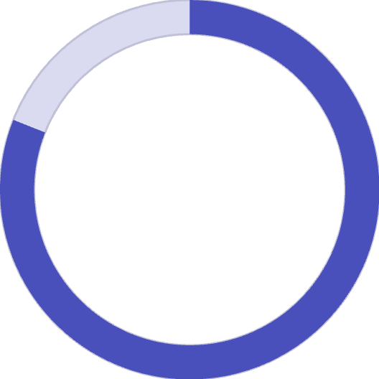
Comprehensive Risk Scoring
0-30%
31-60%
61-80%
LOW
MEDIUM
HIGH
Safe levels
Monitor closely
Prepare action
81-100%
CRITICAL
Urgent response

Slide 9
Powerful Features Dashboard
Real-Time Monitoring
Predictive Analytics
ICU beds, oxygen, ventilators, blood , Pharmacy stocks and staff availability simultaneously
Time-to-failure calculations for each resource with hour-by-hour forecasting
Intelligent Alerts
Flexible Rules Engine
Customizable threshold-based warnings sent before critical situations develop
Easily modify thresholds, dependencies, and weights through JSON configuration files
Scenario Simulation
Test various resource scenarios to understand system behavior and optimize response plans

Slide 10



Real Impact & Benefits
Operational Excellence
Emergency Readiness
Strategic Planning
Optimize resource allocation and reduce waste through predictive planning. Minimize emergency procurement costs.
Prepare for surge events with advance notice. Ensure critical resources are available when lives depend on them.
Make data-driven decisions on procurement, staffing, and capacity management with transparent logic.
100%
2-4hrs
7+
Explainable
Early Warning
Resources Tracked
Zero black-box ML—pure logic every staff member can understand and trust
Predict failures hours before they occur, enabling proactive response
Comprehensive monitoring of all critical hospital resources simultaneously

Slide 11
Future Enhancements Roadmap
Live Data Integration
1
Connect directly to Hospital Information Systems (HIS) for real-time streaming data and automated monitoring
2
Multi-Channel Alerts
Deploy WhatsApp and SMS notifications to ensure critical staff receive warnings instantly, wherever they are
Network Predictions
3
Enable multi-hospital resource sharing and regional capacity forecasting for coordinated emergency response
4
Advanced Visualization
Interactive graph-based dashboards showing resource trends, dependency maps, and prediction timelines
Intelligent Scheduling
5
Automatically optimize elective surgery schedules based on predicted resource availability
6
Optional ML Enhancement
Hybrid system combining explainable logic with machine learning for enhanced pattern recognition

Slide 12
Thank you…

